Slide 1
STUDENT COUNTER USING FACE DETECTION ALGORITHMS
Shri Shankaracharya Institute of Professional Management & Technology, Raipur
Major Project(Phase-I) Report on
CSE 7th Semester
Department of Computer Science and Engineering,
Batch 2019-2023
Session July – Dec 2022
Presentation Date:
24-01-2023
Project Group Members:
Vishal Rathi
Tushar Dubey
Kanha Agrawal
Project Guide
Dr. J P Patra
(HOD,CSE Department)

Slide 2
Introduction about Project
There may be a need to count how many people are in a large room. If a person tries to count, there is a very high possibility of inaccurate data, more over this will take a lot of time. Hence to overcome this hectic work, we have a project that works on the principles of a tiny face detection algorithm. This project explores three phases: Capturing, Processing, and Display. In the first phase, we have an HD camera which is used to capture the image of the room via a microcontroller. The second phase consists of applying the pre-trained deep network to the image to detect tiny faces, and in the third phase of our project which is to display the number of people in a room.

Slide 3
Application Area
Many a times students leave their institution in between the classes and since it quite hectic for authorities to check each and every time number of students seating in a classroom, we wanted to build something which can help authorities to know number of student seating in a class so that they can take any important step according to requirement.
Used to know how many students are there in each class.
Helps in taking decisions of various actions (like merging sections)
Higher authorities, Head of Departments and faculty.

Slide 4
Literature Review
One of the most productive fields of research in machine learning is computer vision. Within the last 20 years, significant advancements in this area have been made. A model to train deep neural networks to the required depth was put forth by Hinton et al. in 2006. Then, in 2012, a breakthrough was made possible by the creation of an 8-layer neural network that performed better than all other algorithms at identifying photos in ImageNet. They used convolutional layers to correct their architecture's linear activation and dropout. Their findings paved the door for stronger computer vision algorithms to be created.FaceNet's accuracy on the LFW database in 2015 was 99.63% utilizing the GoogleNet-24 framework. On the LFW database, Parkhi et alwork .'s on the VGGFace led to an accuracy of 98.95%.

Slide 5
Methodology
Our system will capture the image of the classroom using a webcam and then send that to the server and after computing the image, send the desired result to the respected authority. Typically, this process can be divided into three stages.
Image Capturing
Server
Display Unit
Experimental Setup
Import dependencies and GitHub Repository from https://github.com/vishal6789/Student-Counter
Database Used
MongoDB

Slide 6
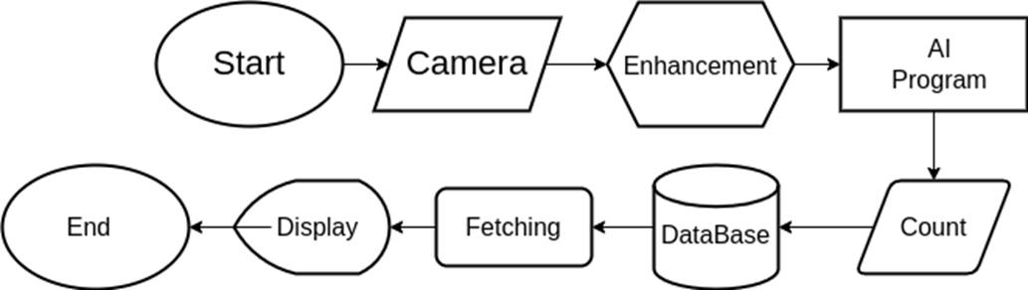
Project Workflow Diagram

Slide 7
Result & Conclusion
This system aims to ease the task of counting the students sitting in each classroom. The proposed system will be able to detect the number of students sitting in a classroom. For Tiny Face Detection, a pre-trained Residual Network is used. It will capture faces via webcam. After capturing, it will send the image for computation (i.e. detecting the number of students sitting in a classroom or lab) and then send the count to authorities and display them via GUI. The Student Counter System helps in increasing the accuracy and speed ultimately achieving the real-time calculations of students present in a classroom. It not only reduces the chances of errors that can be made by humans but also reduces human interaction and at the same time increases its efficiency. It reduces the time taken to complete the task too. Face detection is an emerging technology that can provide many benefits. Face detection can save resources and time, and even generate new income streams, for companies that implement it right.

Slide 8
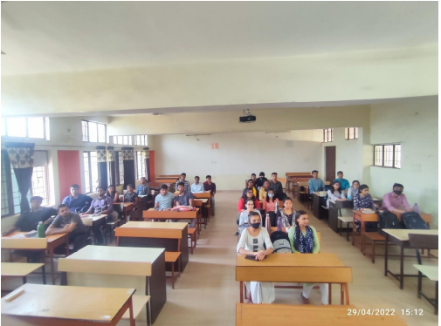
Result & Conclusion
Image Capturing

Slide 9
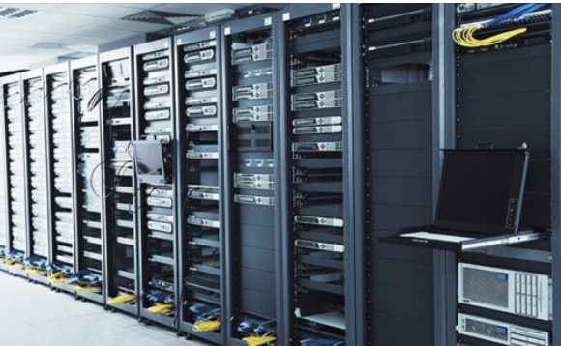
Result & Conclusion
Server Room
Uploading Images To Server

Slide 10
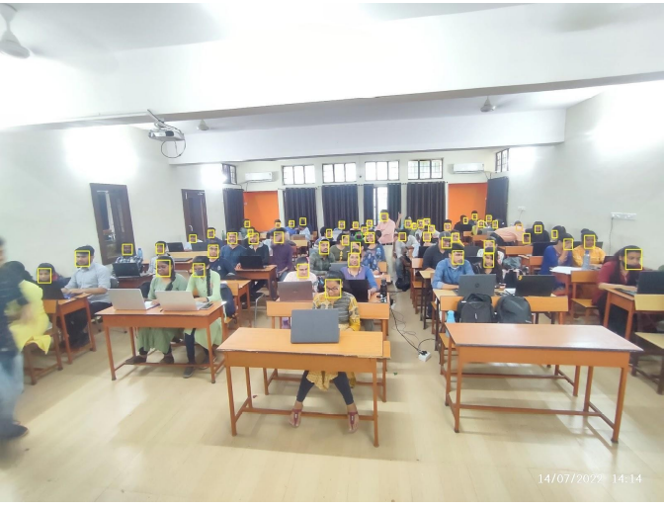
Result & Conclusion
Detecting Faces
Detecting Faces

Slide 11
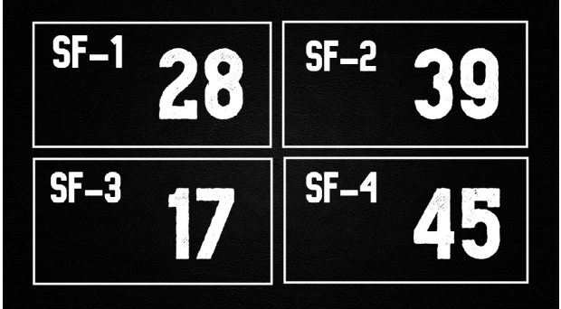
Snapshot
User Interface Display

Slide 12
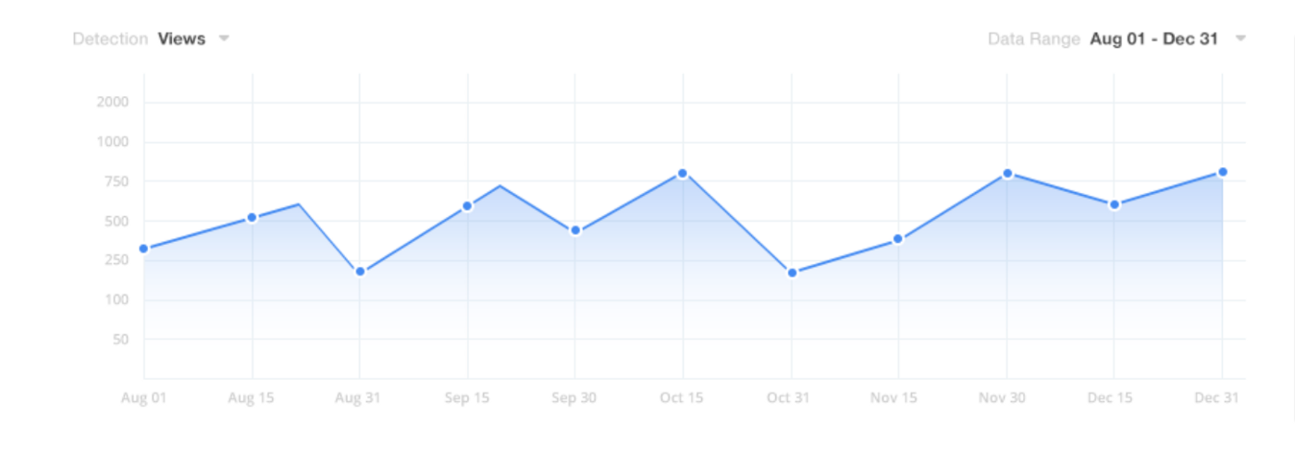
Snapshots
User Interface Display

Slide 13
References
Raspberry Pi 4 For Beginners And Intermediates: A Comprehensive Guide for Beginner and Intermediates to Master the New Raspberry Pi 4 and Set up Innovative Projects by Craig Berg https://singleboardbytes.com/647/install-opencv-raspberry-pi-4.htm
NVIDIA Jetson nano official website: https://forums.developer.nvidia.com/t/official-tensorflow-for-jetson-nano
Raspberry pi official website: https://www.raspberrypi.org/
Dependencies on Jetson Nano
https://qengineering.eu/install-tensorflow-2.4.0-on-jetson-nano.html
For Research paper reference: https://scholar.google.com/

Slide 14
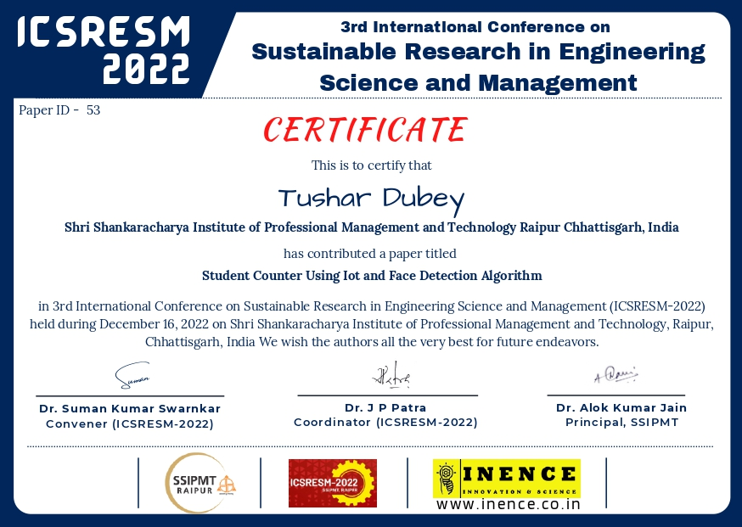

Paper Publication Details

